Slide 1
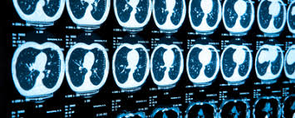
MRI Segmentation: Swin-Unet: Unet-like Pure Transformer for Medical Image Segmentation
Alireza Samadifardheris

Slide 2
ROADMAP
Data
Results
Introduction
Why img. Seg.
Popular methods
Their Problems
solution
1
3
5
2
4
6
Swin-Unet
The code

Slide 3
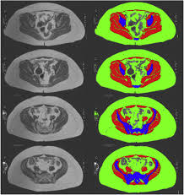
1. Introduction: 1.1. why image segmentation
development of deep learning, -> computer vision widely used in medical image analysis.
Image segmentation is an important part of medical image analysis. In particular, accurate and robust medical image segmentation can play a cornerstone role in computer-aided diagnosis and image-guided clinical surgery

Slide 4
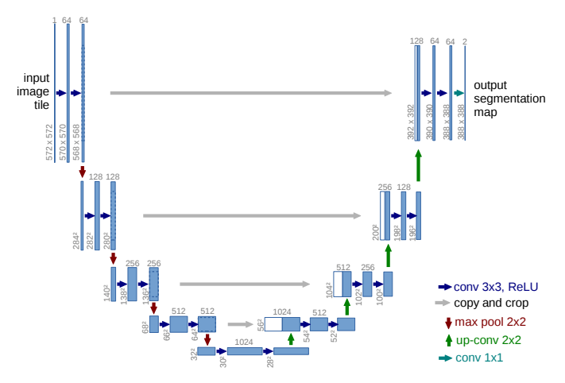
1. Introduction: 1.2. popular methods for Img. Seg.
Existing medical image segmentation methods mainly rely on fully convolutional neural network (FCNN) with U-shaped structure
U-Net , consists of a symmetric Encoder-Decoder with skip connections. :
In the encoder, a series of convolutional layers and continuous down- sampling layers are used to extract deep features with large receptive fields.
Then, the decoder up-samples the extracted deep features to the input resolution for pixel-level semantic prediction,
and the high-resolution features of different scale from the encoder are fused with skip connections to alleviate the loss of spatial information caused by down-sampling.
-great success in a variety of medical imaging applications
3D U-Net , Res-UNet , U-Net++ and UNet3+ have been developed

Slide 5

1. Introduction: 1.3. how do they work
Lets skip this for now and discuss in detail because they are related to our model

Slide 6

1. Introduction: 1.4. Their problem
still cannot fully meet the strict requirements of medical applications for segmentation accuracy.
Image segmentation is still a challenging task in medical image analysis. reason :
the intrinsic locality of convolution operation
it is difficult for CNN-based approaches to learn explicit global and long-range semantic information interaction
Some enhancements suggested, However, they still have limitations in modeling long-range dependencies.

Slide 7
1. Introduction: 1.5. solution
inspired by Transformer’s great success in NLP , researchers have tried to bring Transformer into the vision domain.
1. vision transformer (ViT) is proposed to perform the image recognition task. Taking 2D image patches with positional embeddings as inputs and pre-training on large dataset, ViT achieved comparable performance with the CNN-based methods.
2. data-efficient image transformer (DeiT) is then presented , which indicates that Transformer can be trained on mid-size datasets.
3. then a hierarchical Swin Transformer is developed. with Swin Transformer as vision backbone with great performance on Image classification, object detection and semantic segmentation.

Slide 8
Swin-Unet
Motivated by the Swin Transformer’s [19] success, we propose Swin-Unet to leverage the power of Transformer for 2D medical image segmentation in this work

Slide 9
2. Swin-Unet overview
the first pure Transformer-based U-shaped architecture consists of encoder, bottleneck, decoder, and skip connections.
The tokenized image patches are fed into the Transformer-based U-shaped Encoder-Decoder architecture with skip-connections for local-global semantic feature learning.
Specifically: hierarchical Swin Transformer with shifted windows as the encoder to extract context features.
And a symmetric Swin Transformer-based decoder with patch expanding layer to perform the up-sampling operation to restore the spatial resolution of the feature maps.
It is shown that the pure Transformer-based U-shaped Encoder-Decoder network outperforms those methods with full-convolution or the combination of transformer and convolution

Slide 10
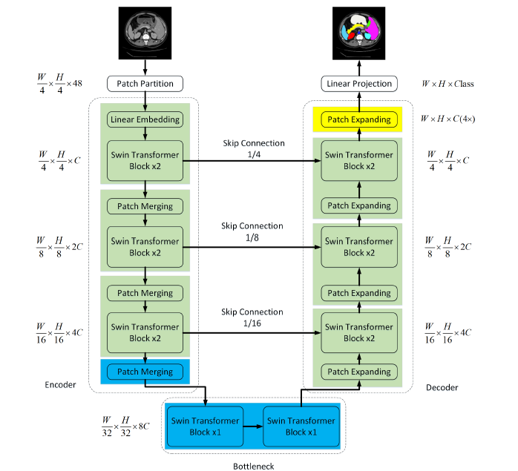
2.2. architecture overview

Slide 11
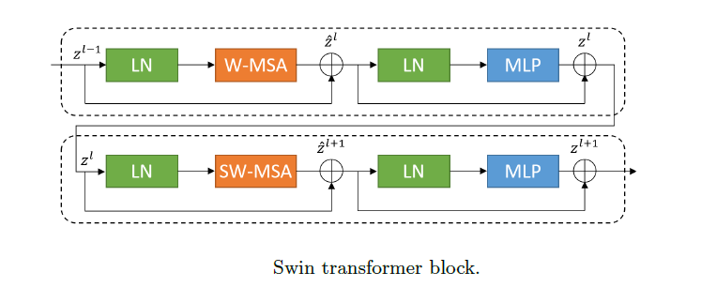
2.2. 1. architecture overview Swin Transformer block
LN : LayerNorm (LN) layer
W-MSA: window-based multi-head self attention module
SW-MSA : shifted window-based multi-head self attention

Slide 12
2.2.2 . architecture overview Encoder

Slide 13
2.2. 3. architecture overview Bottleneck

Slide 14
2.2. 4. architecture overview Decoder

Slide 15
2.2. 5. architecture overview Skip connection

Slide 16
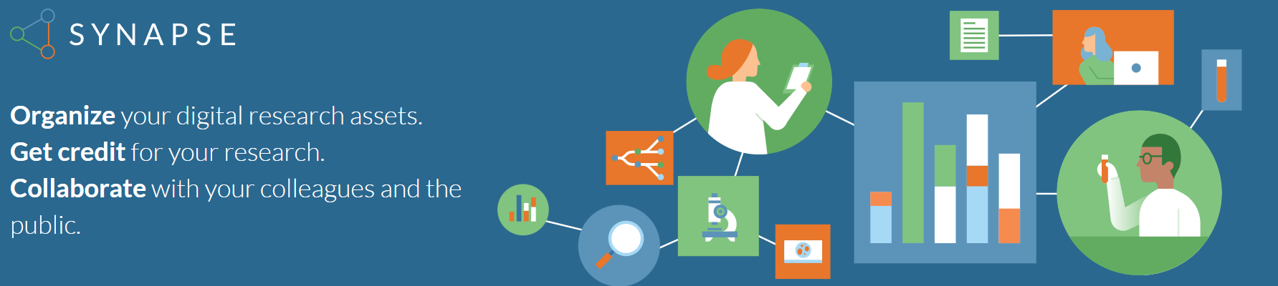
3. Data
Synapse multi-organ segmentation dataset (Synapse)
the dataset includes 38 cases with 3779 axial abdominal clinical CT images
26 samples are divided into the training set and 12 samples into testing set.
And the average Dice-Similarity coefficient (DSC) is used as evaluation metric to evaluate our method on 8 abdominal organs (aorta, gallbladder, spleen, left kidney, right kidney, liver, pancreas, spleen, stomach).

Slide 17
DISCLAIMER
This presentation is for the Neural Network project only
DO NOT USE THIS CODE FOR SELF DIAGNOSING AND CONTACT HEALTH AUTHORITIES

Slide 18

4. Let’s dive into the code now!

Slide 19
THANKS!
Any questions?
You can find me at:
Samadifardheris.1961823@studenti.uniroma1.it

Slide 20
CREDITS
Swin-Unet: Unet-like Pure Transformer for Medical Image Segmentation Hu Cao1
https://synapse.org/
https://github.com/HuCaoFighting/Swin-Unet

